Slide 1
CSE570 Spring 2020 Wireless and Mobile Networks
Mobile Video
The slides are borrowed from Dr. Timmerer [AAU/Bitmovin]’s tutorial at Sigcomm’17

Slide 2
Explosion in Mobile Video Applications

Slide 3
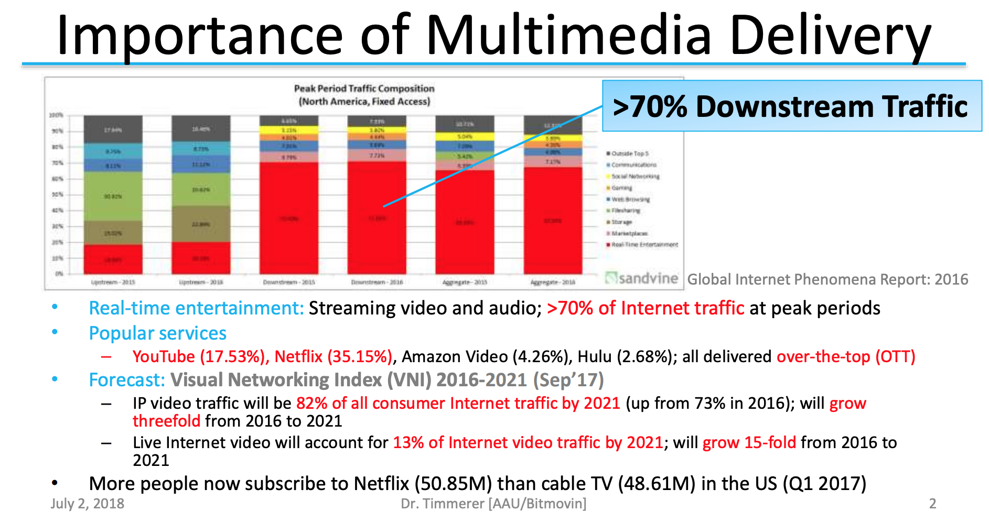
Importance of Internet Media

Slide 4
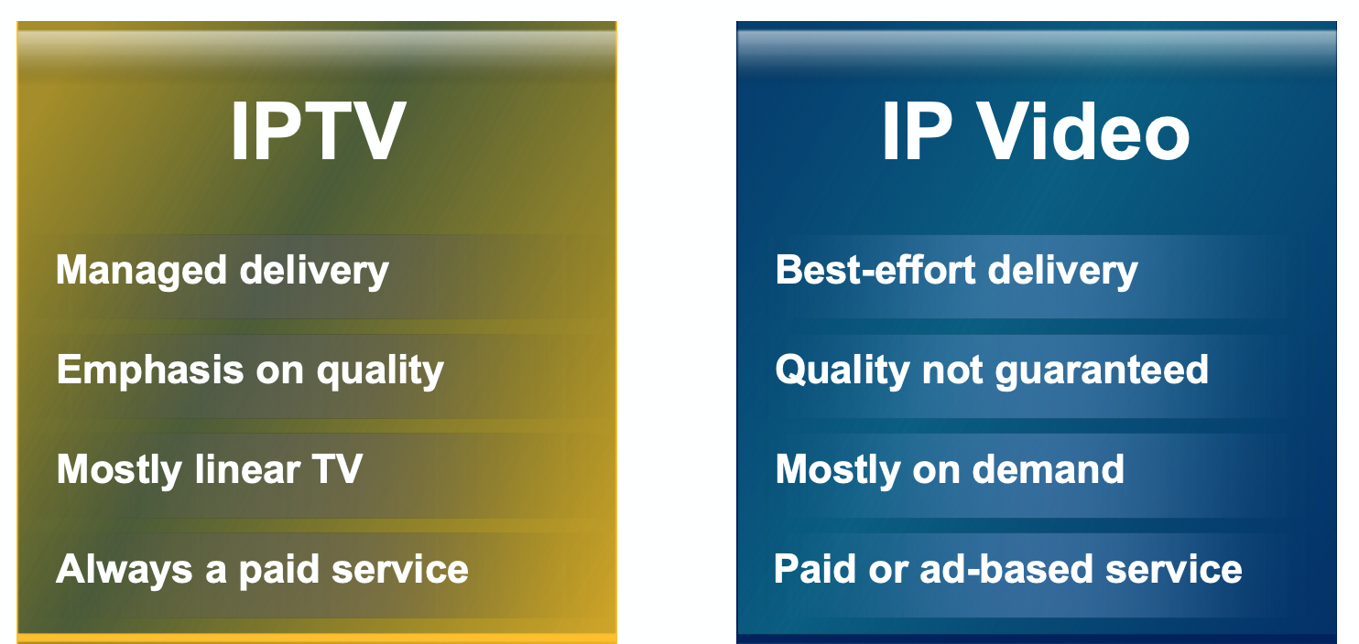
Beginning of Internet Video

Slide 5
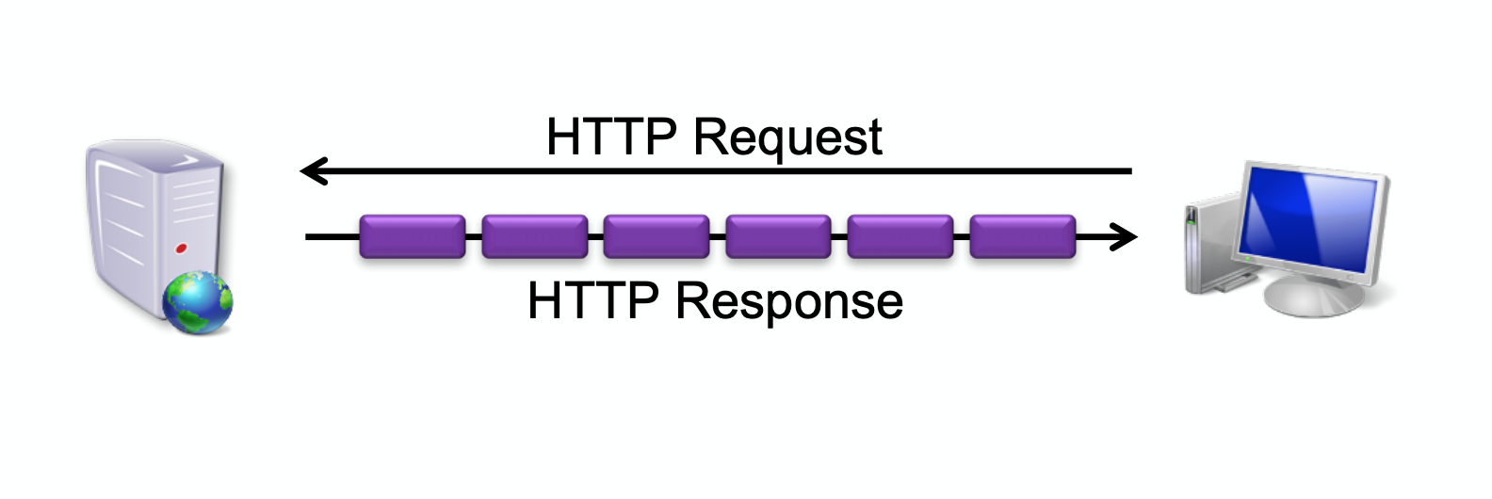
Progressive Download
One request, One response

Slide 6
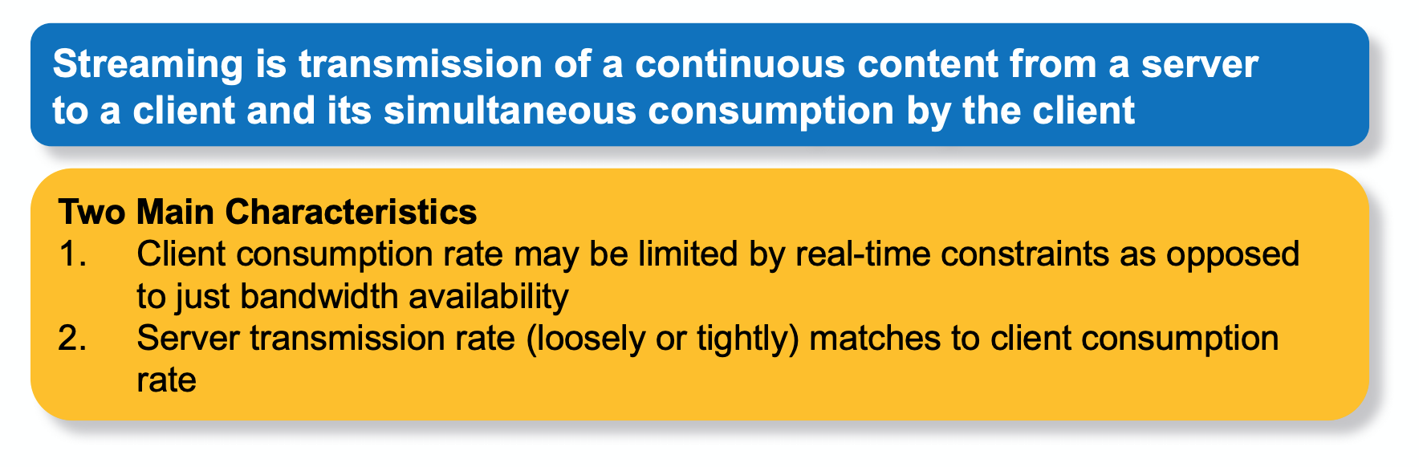
What is Streaming?

Slide 7
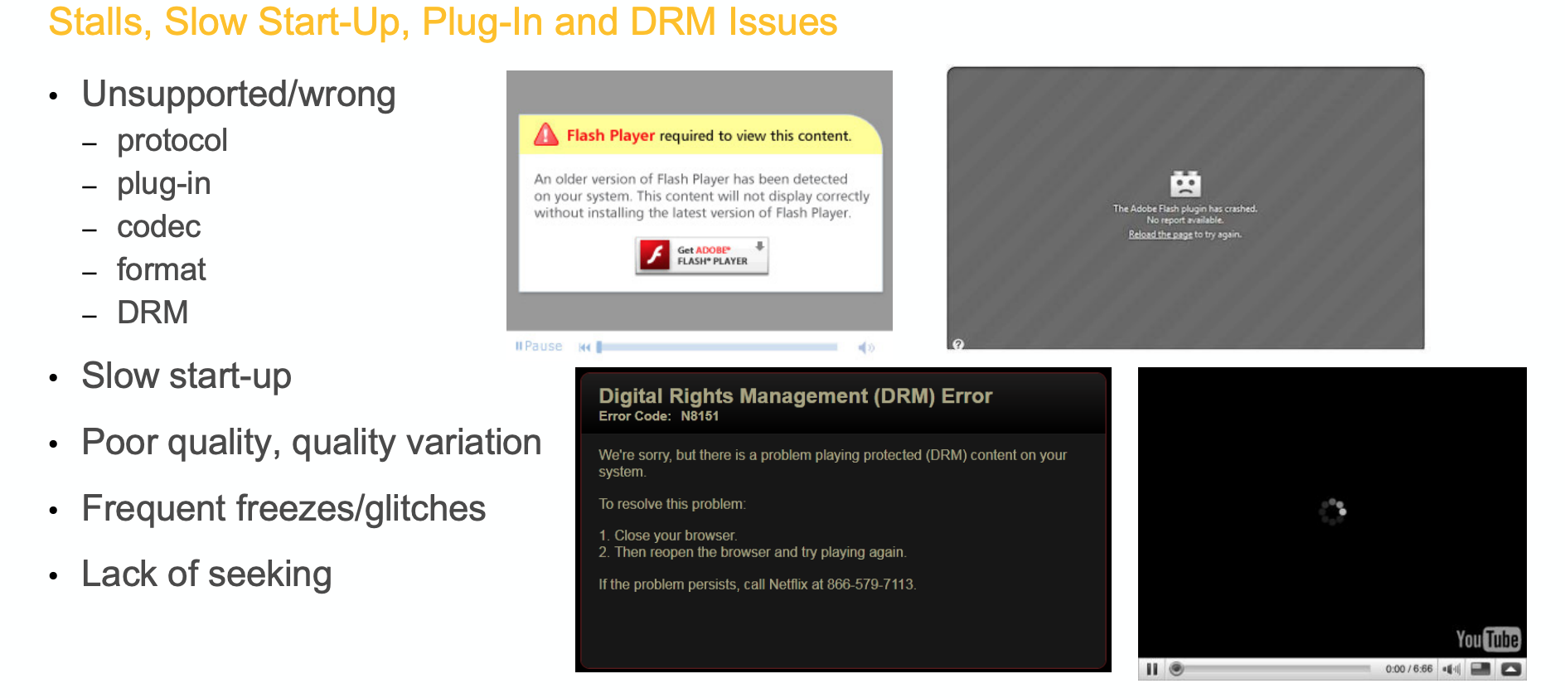
Some common Streaming Issues

Slide 8
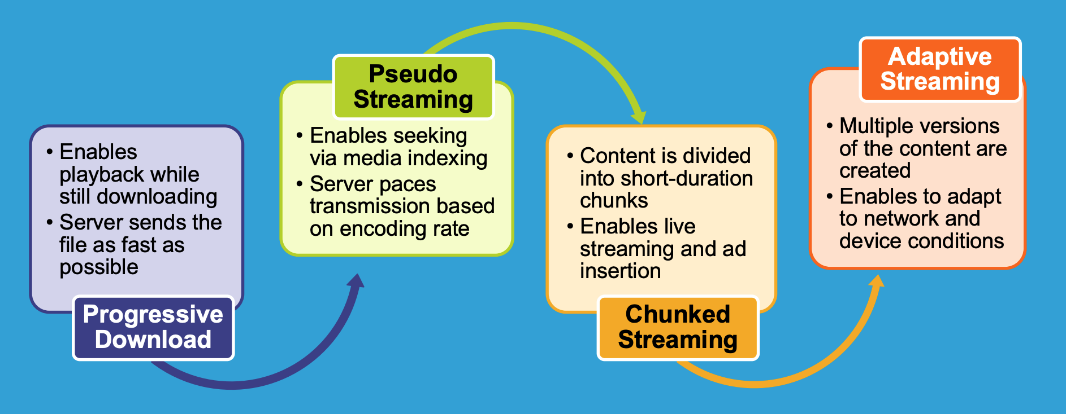
Evolution of Video Streaming

Slide 9
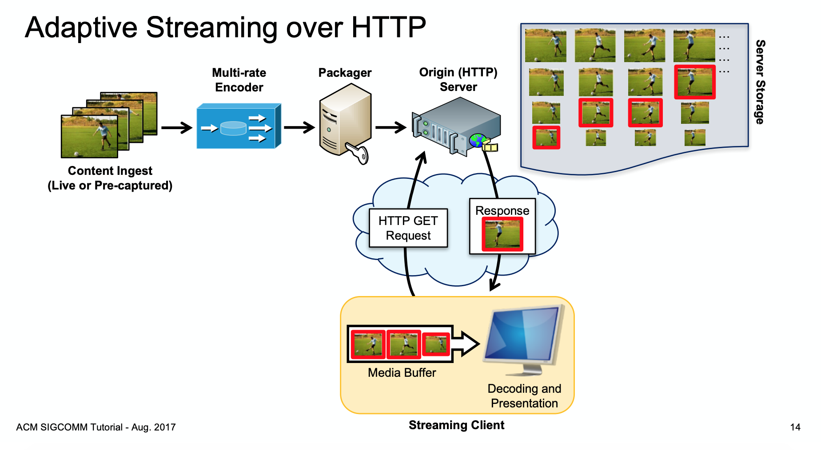
Adaptive Streaming

Slide 10
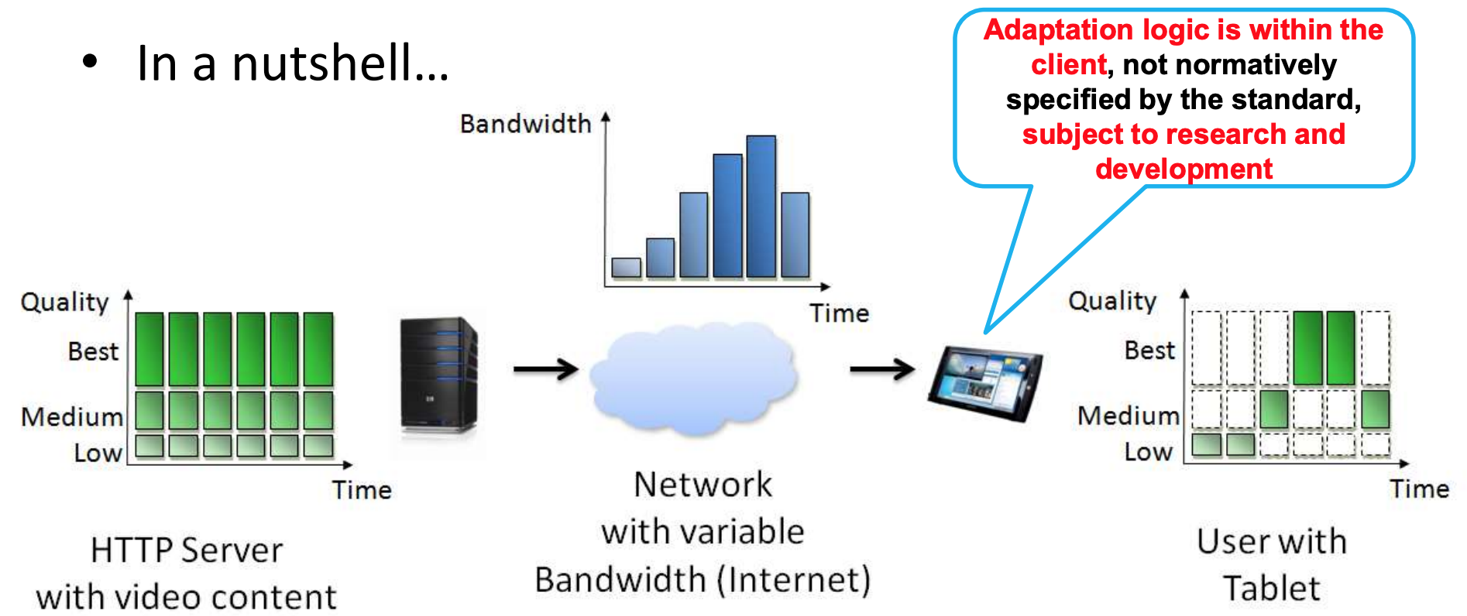
Adaptive Streaming

Slide 11
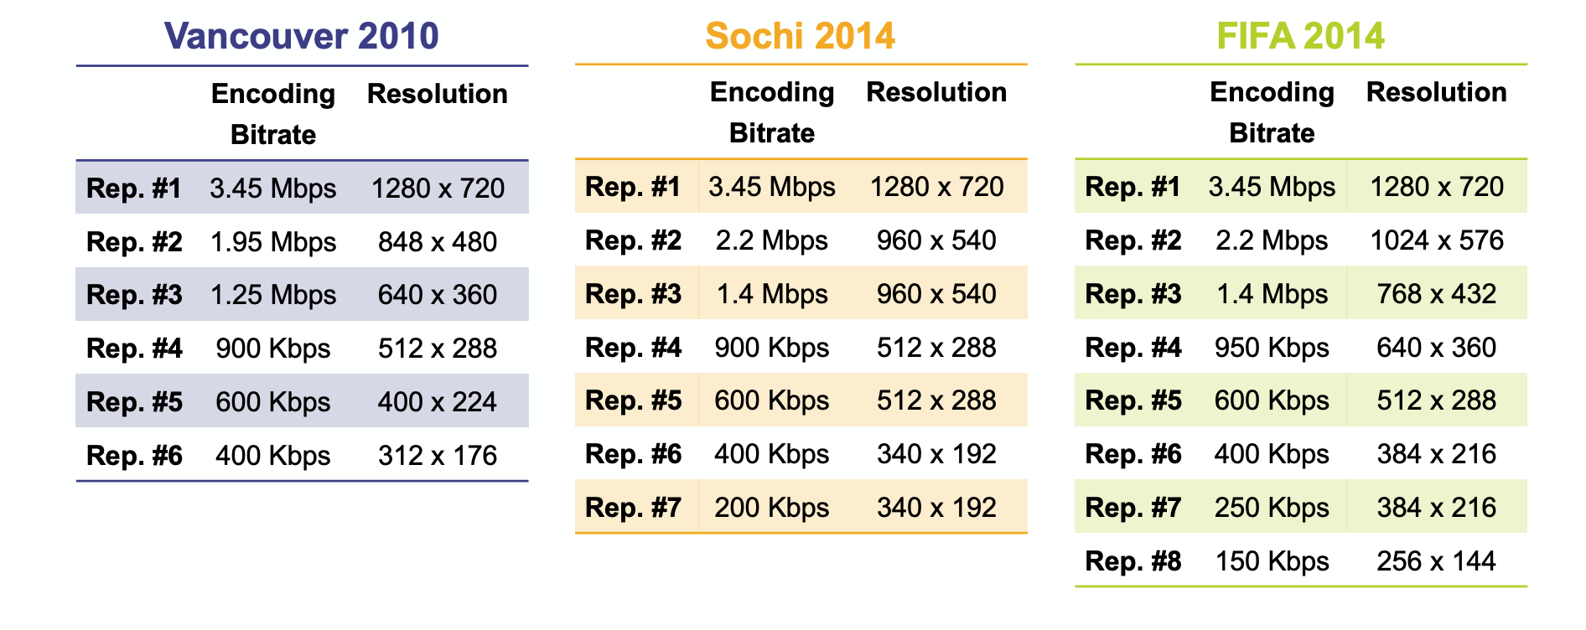
Example Representations

Slide 12
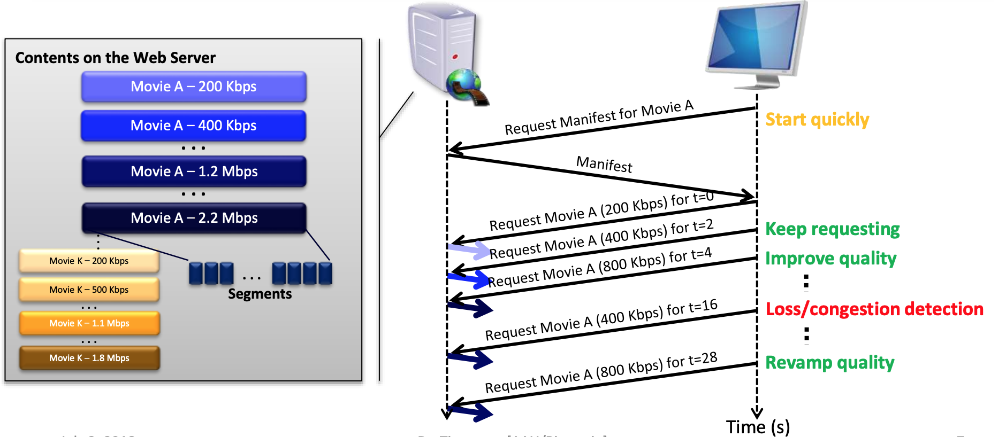
Representation switching

Slide 13
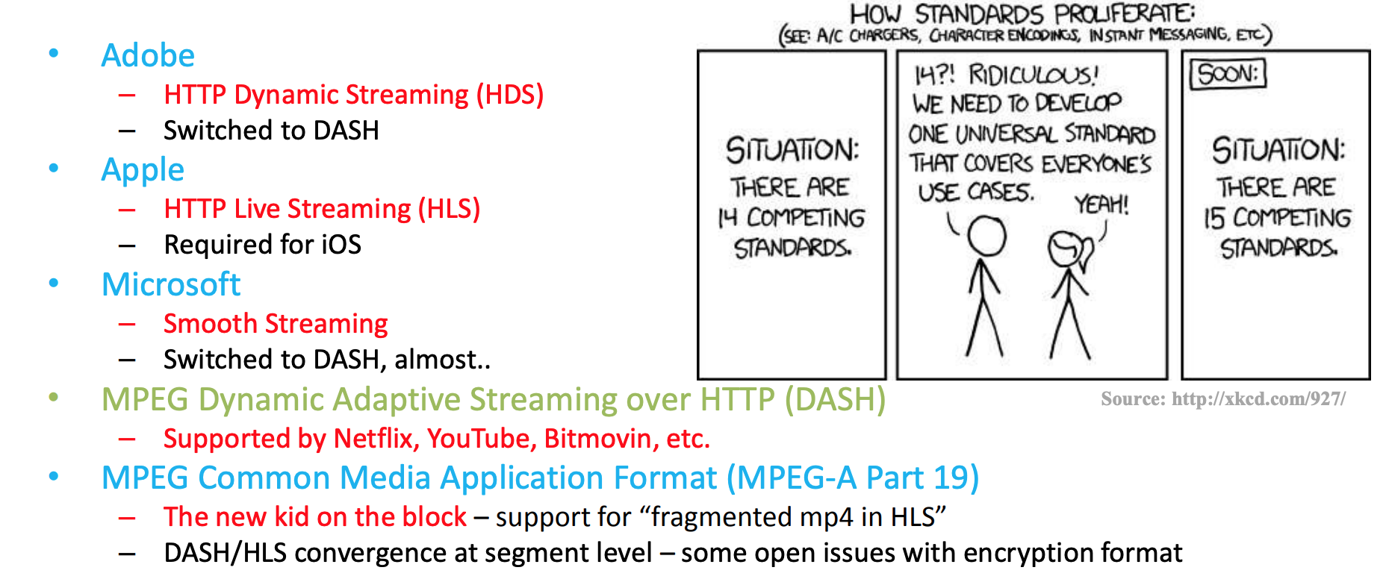
Adaptive Streaming Standards

Slide 14
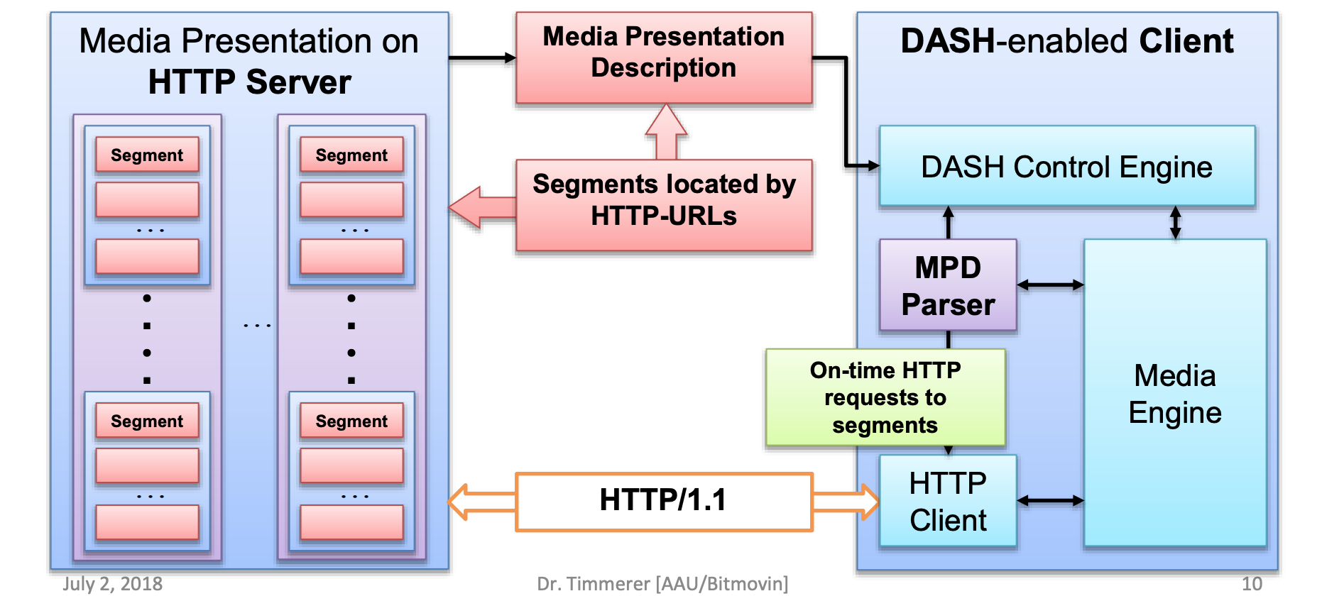
DASH Internals

Slide 15
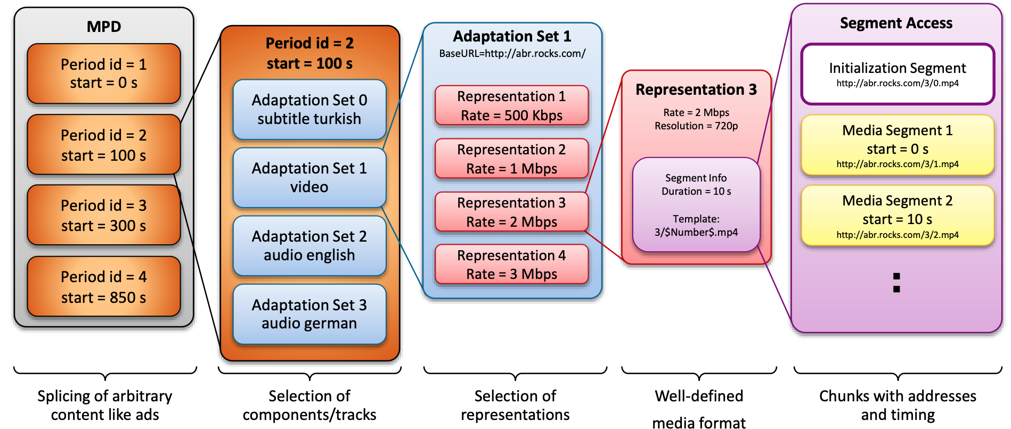
DASH Internals – Manifest File

Slide 16
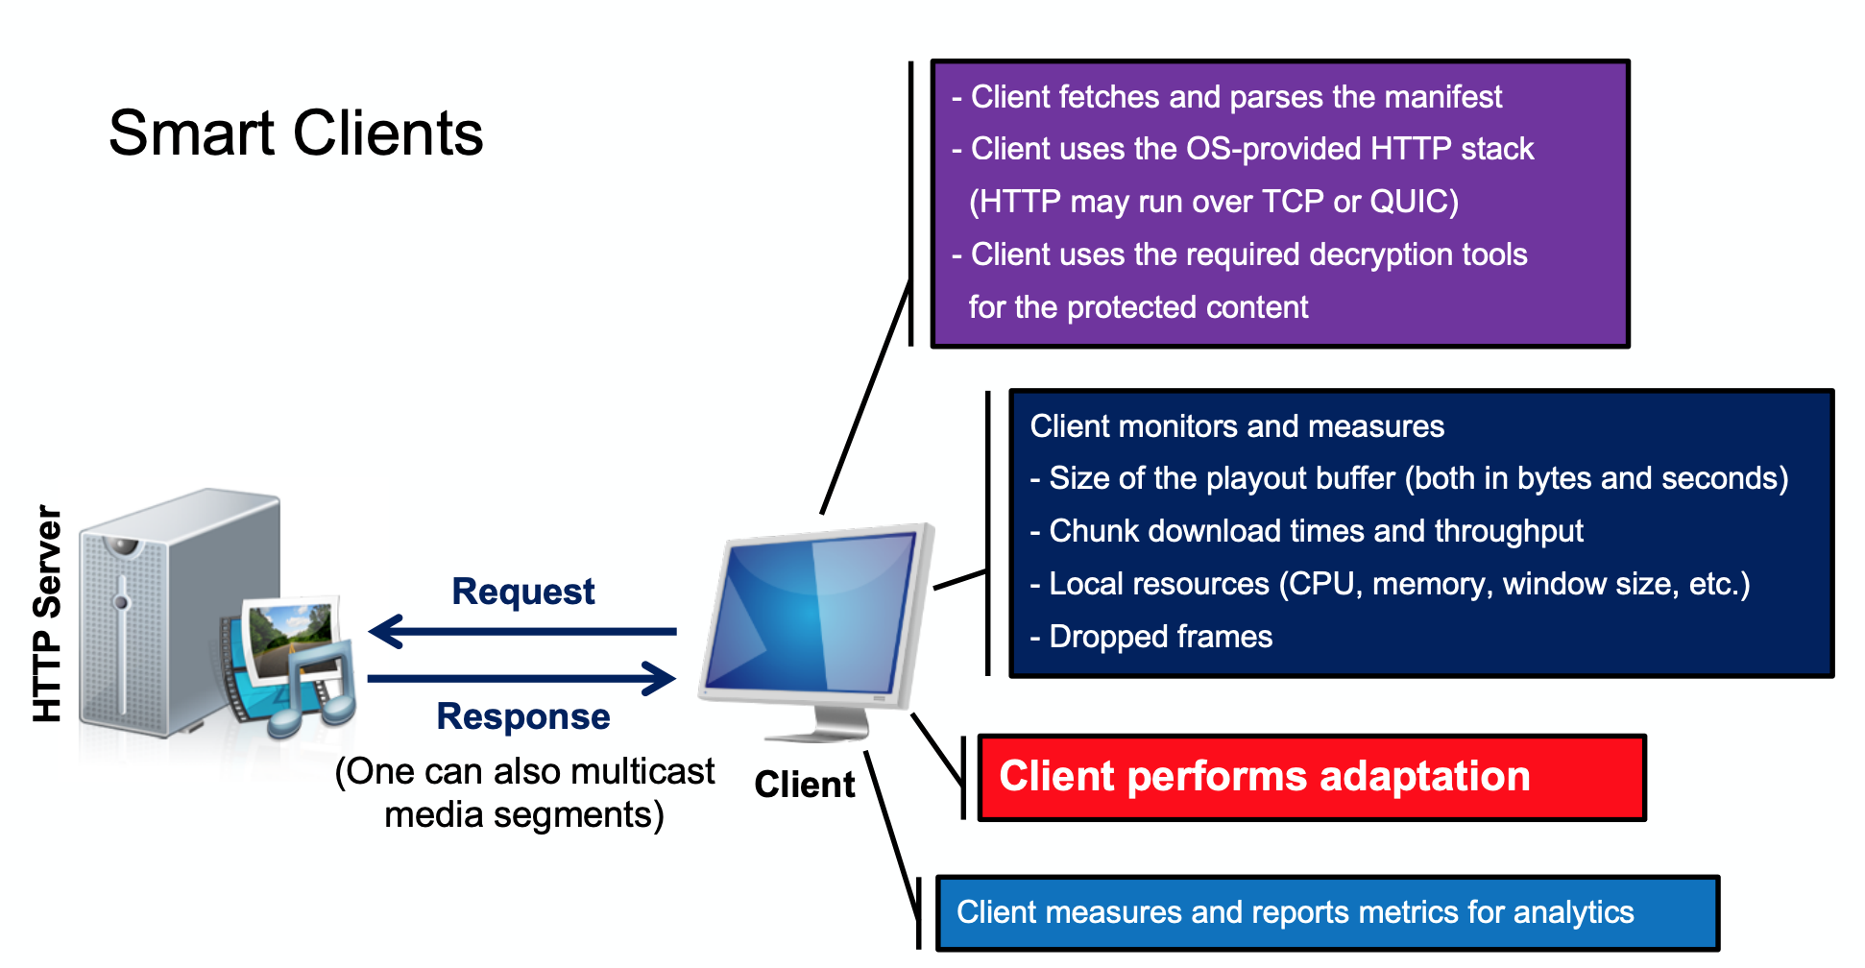
A Typical Client Does

Slide 17
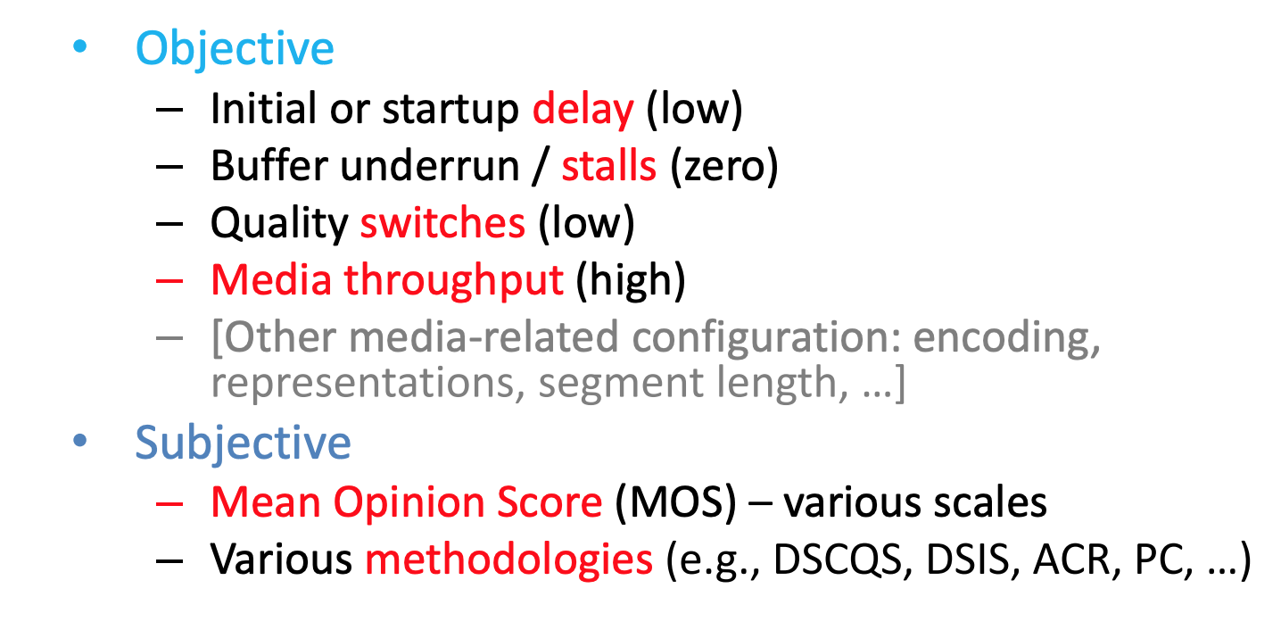
Video Streaming Quality of Experience

Slide 18
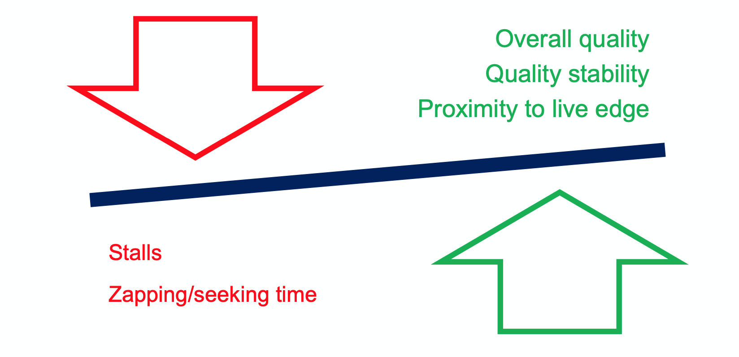
Trade-offs (ABR algorithm)

Slide 19
ABR algorithms
The bitrate adaptation logic is typically controlled by the client
Bitrate adaptation heuristics based on:
Available bandwidth
Playback buffer size
Chunk scheduling
Hybrid-based
Interesting algorithms
Li et al (2014), Liu et al (2011)
Huang et al (2014), Mueller et al (2015)
Jiang et al (2012), Chen et al (2013)
Yin et al (2015), Li et al. (2014), De Cicco et al. (2013), Miller et al. (2012), Zhou et al. (2012)

Slide 20
Summary
Internet Video Traffic is Exponentially Increasing
Wireless Networks often provide unreliable conditions.
Need for Adaptive Streaming
Video Streaming Performance Metrics
Adaptive Streaming for advanced video applications

Slide 21
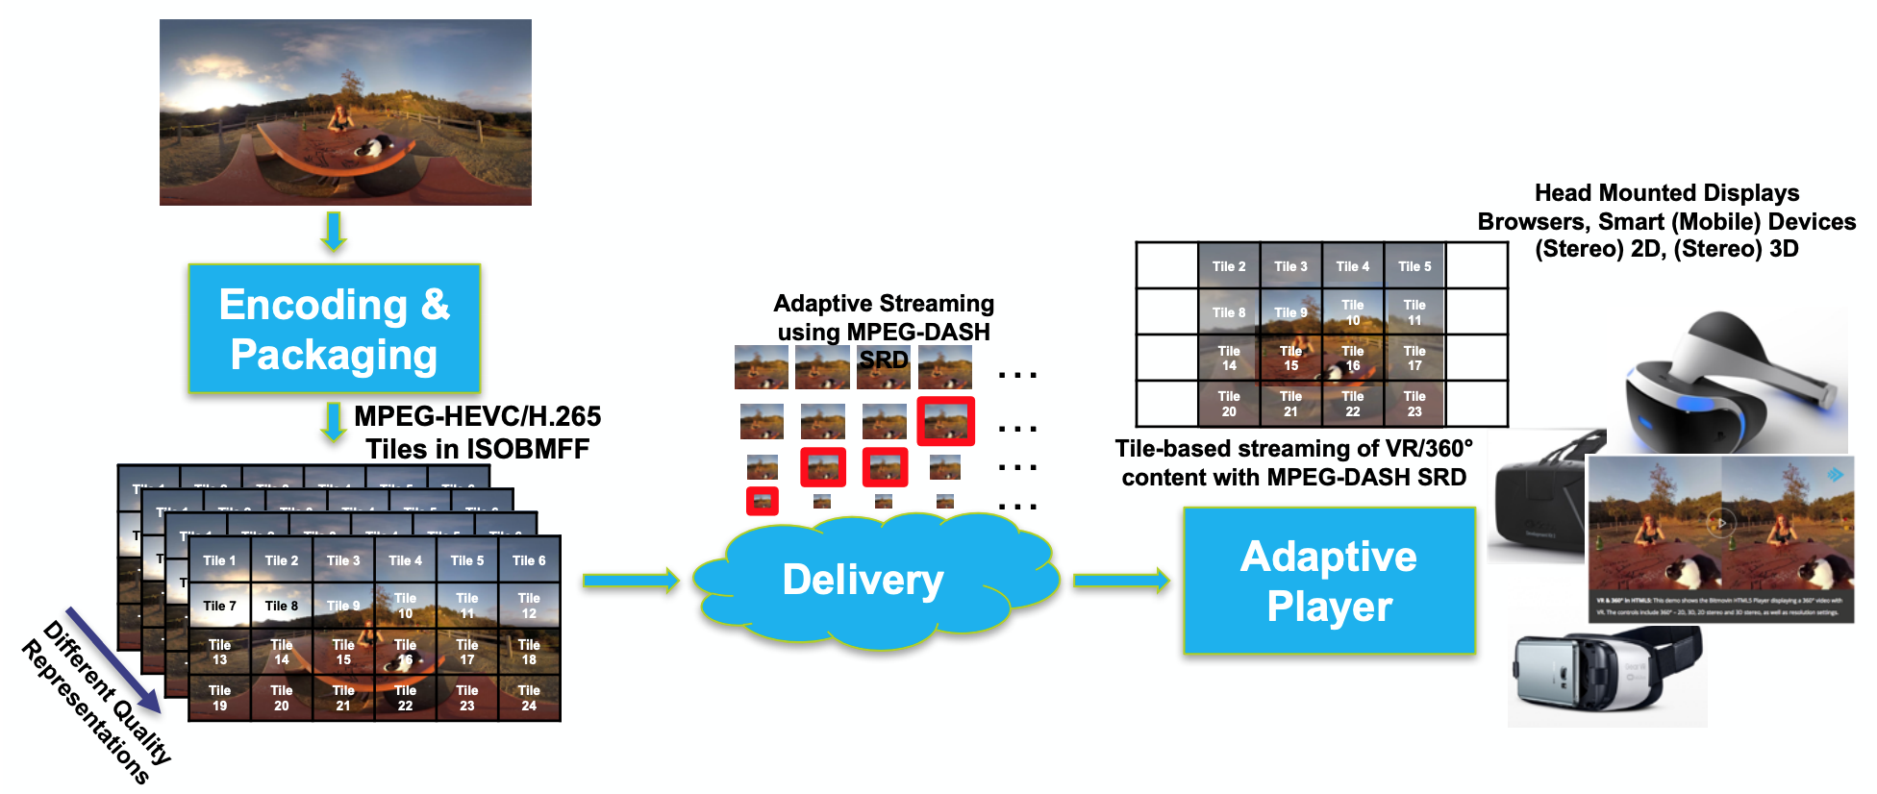
Adaptive Streaming for 360 Degree Videos, VR/AR

Slide 22
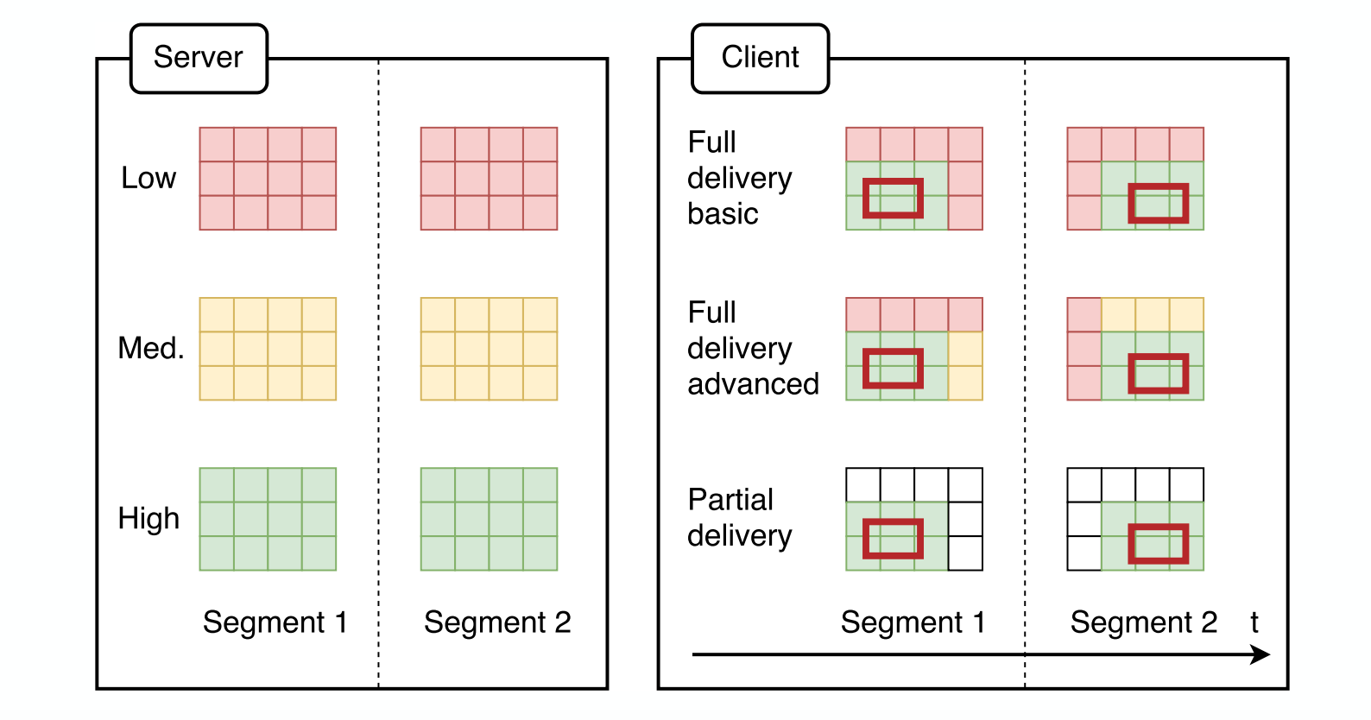
Adaptive Streaming for 360 Degree Videos, VR/AR

Slide 23
Adaptive Streaming – Latest Trends
Bandwidth prediction
Simple statistics
ML
ABR Algorithms
Buffer based (e.g., BBA, BOLA)
Throughput based (e.g., Festive)
Hybrid (e.g., MPC, Pensieve)
Identifying root causes
Client, Server, CDN, Routers

Slide 24
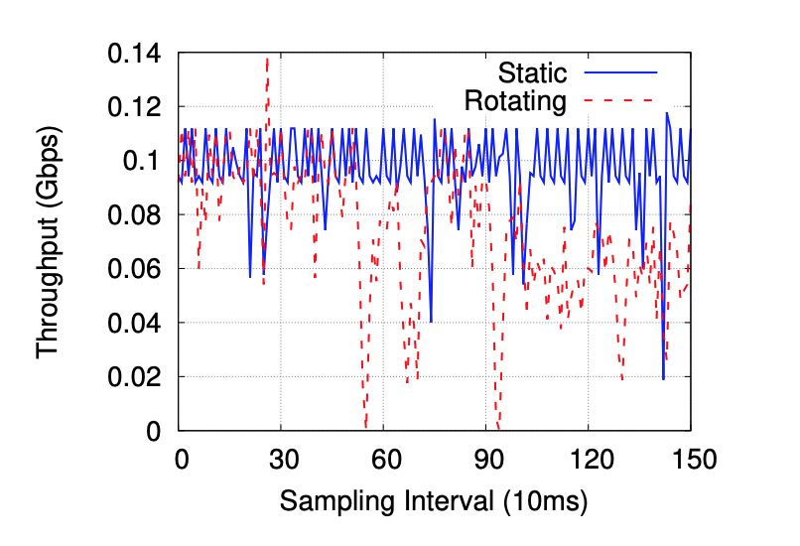
Some Wireless Network Conditions
Reasons for fluctuation?

Slide 25
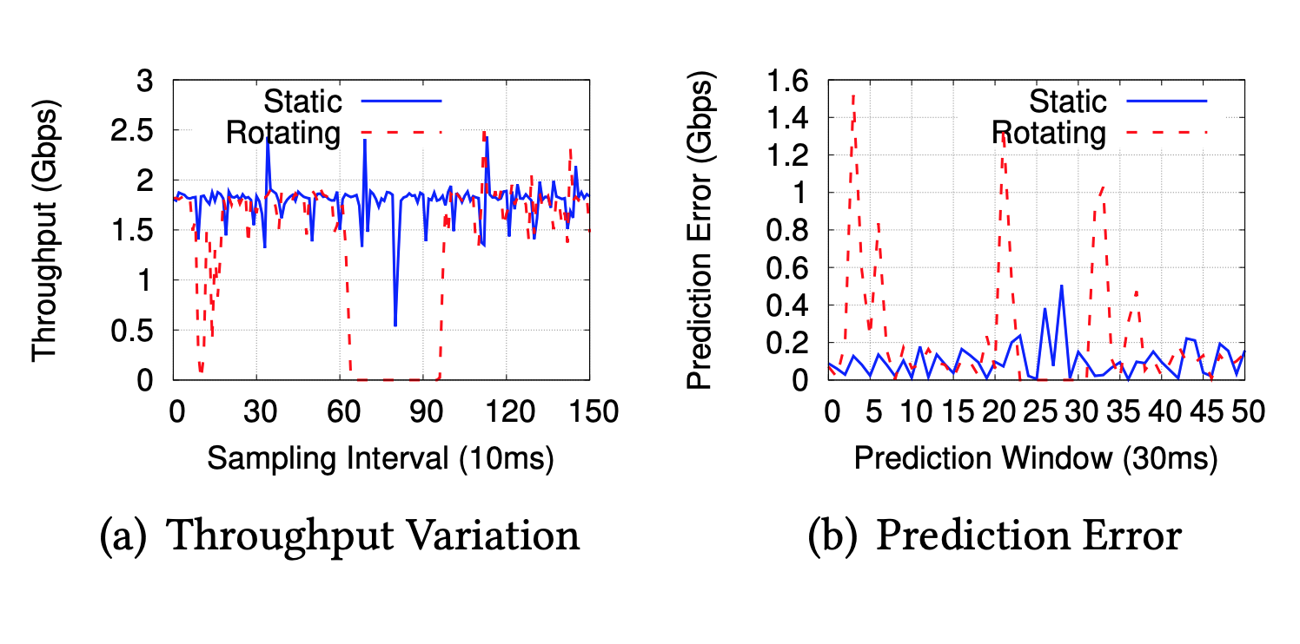
Some Wireless Network Conditions
Increased bandwidth is not enough: reliability matters.

Slide 26
ABR Algorithms
Key performance metrics
Quality (Q), Rebuffering (R), Quality switches (S)
A general objective
Quality of Experience (QoE)
QoE = w1.Q – w2.R – w3.S
Maximize QoE
s.t some constraints

Slide 27
Throughput Based ABR (FESTIVE)
Inefficiency: Fraction of bandwidth not being used or overused
Unfairness: Discrepancy of bitrates used by multiple players
Instability: The frequency and magnitude of recent switches
Bitrate
(Mbps)
Bottleneck b/w 2Mbps
Player A
1.3
0.7
Bitrate
(Mbps)
time
Player B
0.7
27
time

Slide 28
Throughput Based ABR (FESTIVE)
SmoothStreaming (SS)
Akamai
Adobe
Netflix
Unfairness index
Instability index
Inefficiency index
SmoothStreaming (SS) appears to be better than other players.

Slide 29
Throughput Based ABR (FESTIVE)
Many players use this to keep fixed video buffer
e.g., if chunk duration = 2 sec, chunk requests at T= 0,2,4,… sec
Example setup: Total bandwidth: 2Mbps
Bitrate 0.5 Mbps, 2 sec chunks
Chunk size: 0.5 Mbps x 2 sec = 1.0Mb
b/w (Mbps)
2
Throughput: 2 Mbps
1 sec
0.5 sec
1 sec
0.5 sec
1
1 sec
1 sec
Throughput: 1 Mbps
0
1s
2s
time
Throughput: 1 Mbps
Player A, T=0,2,4,…
Player B
T=0,2,4,…
Player C
T=1,3,5,…
Unfair! Start time impacts observed throughput
NOT a TCP problem!

Slide 30
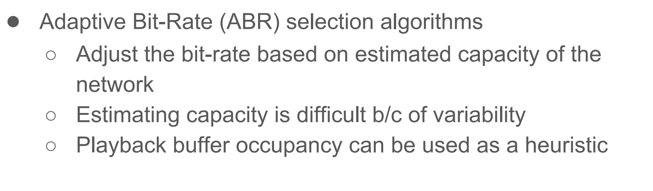
Buffer Based ABR (BBA)

Slide 31
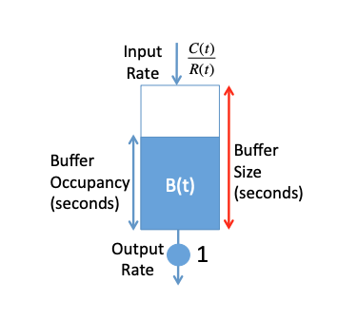
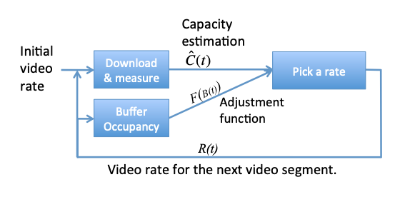
Buffer Based ABR (BBA)
Picks Video Rate R(t), with capacity C(t)
Capacity overestimation leads to buffer depletion quickly
Difficult to pick the right adjustment function when C(t) is highly variable in practice

Slide 32
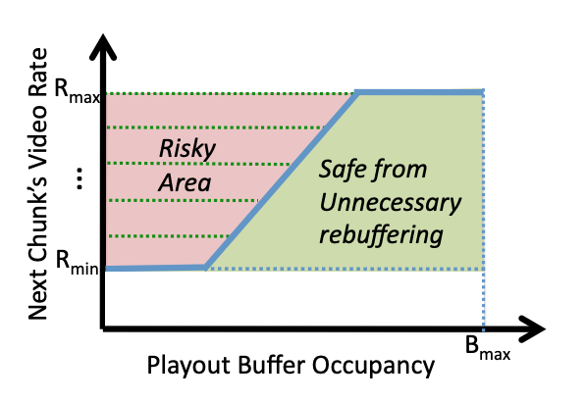
Buffer Based ABR (BBA)
Pure Buffer based approach
A function of the current buffer occupancy, B(t)
A function that produces a video rate between Rmin and Rmax given the current buffer occupancy.

Slide 33
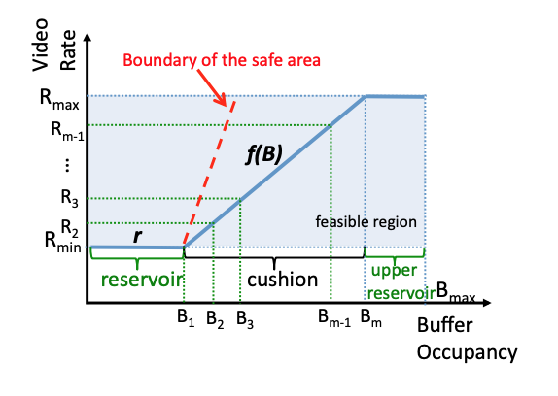
Buffer Based ABR (BBA)

Slide 34
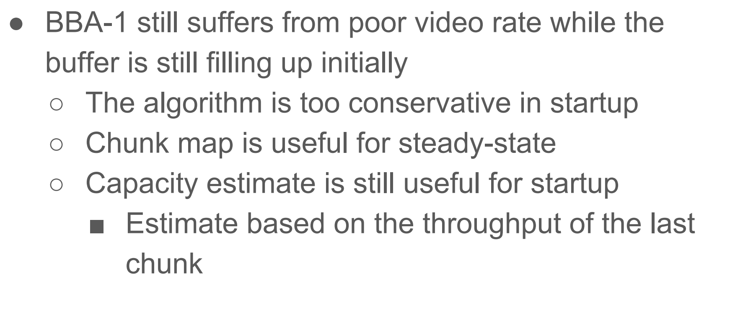
Buffer Based ABR (BBA2)

Slide 35
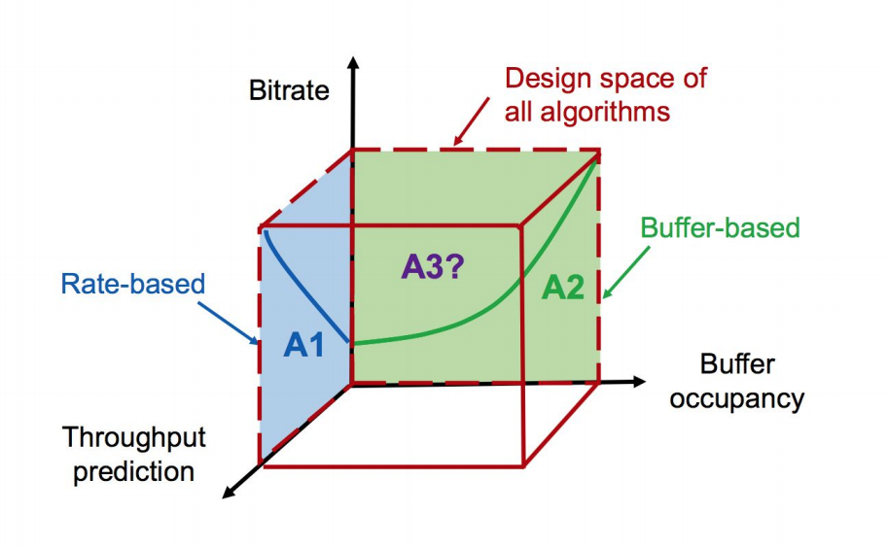
Throughput and Buffer Based ABR (MPC)

Slide 36
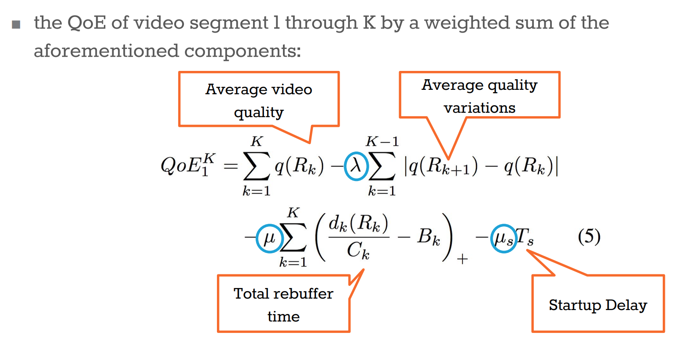
Throughput and Buffer Based ABR (MPC)

Slide 37
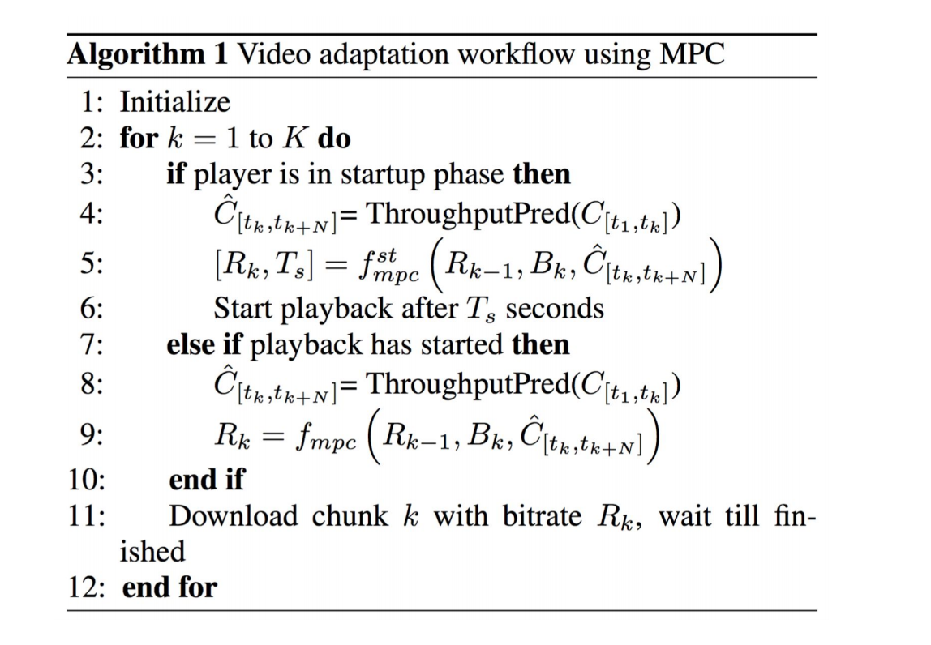
Throughput and Buffer Based ABR (basicMPC)

Slide 38
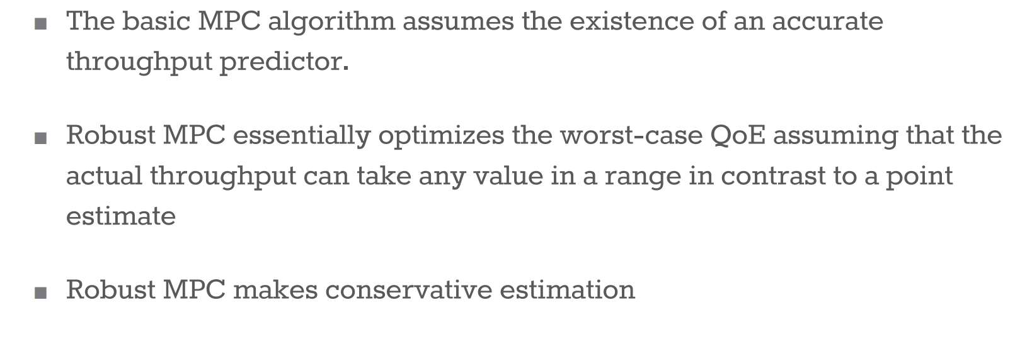
Throughput and Buffer Based ABR (robustMPC)

Slide 39
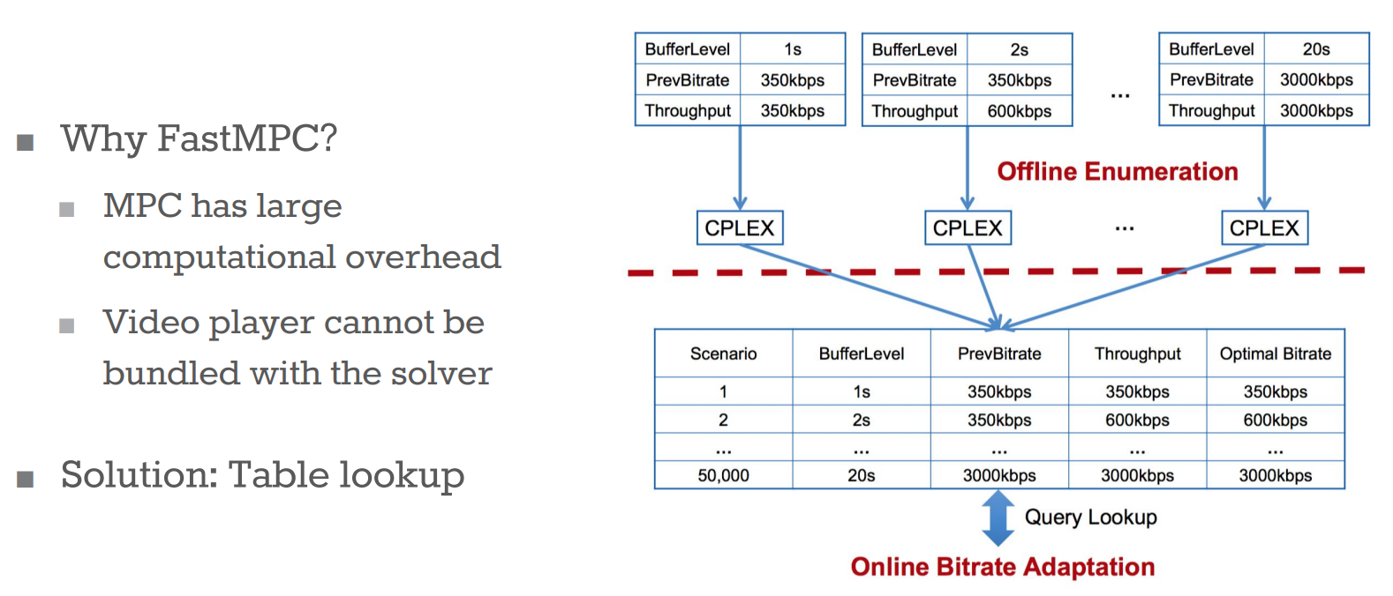
Throughput and Buffer Based ABR (fastMPC)

Slide 40





Learning Based ABR (Pensieve)
bandwidth
ABR agent
bitrates
240P
bit rate
480P
720P
buffer
720P
1080P
network and video measurements
Pensieve learns ABR algorithm automatically through experience

Slide 41
Fast Switching
Responsiveness to higher network throughput by replacing segments already in the buffer
Decide whether to download a new segment or a replacement segment
Determine which segment to replace
Works with both throughput based and buffer-based ABR algorithms
Any problems with buffer based?

Slide 42
Summary
ABR for advanced video applications
ABR Algorithms
Buffer based
Throughput based
Hybrid
Learned
Bandwidth prediction
Fast switching for high throughput network

